Slide 1
The 2025 Lighting Design Awards Gala
IES Ottawa

Slide 2
Past President Title Slide
Volunteer Recognition
Presentation of
Past Section President Pin

Slide 3
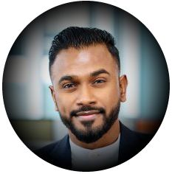
Photo of Emerson with dates served
Emerson Joekumar
IES Ottawa
Section President
2023-2025

Slide 4
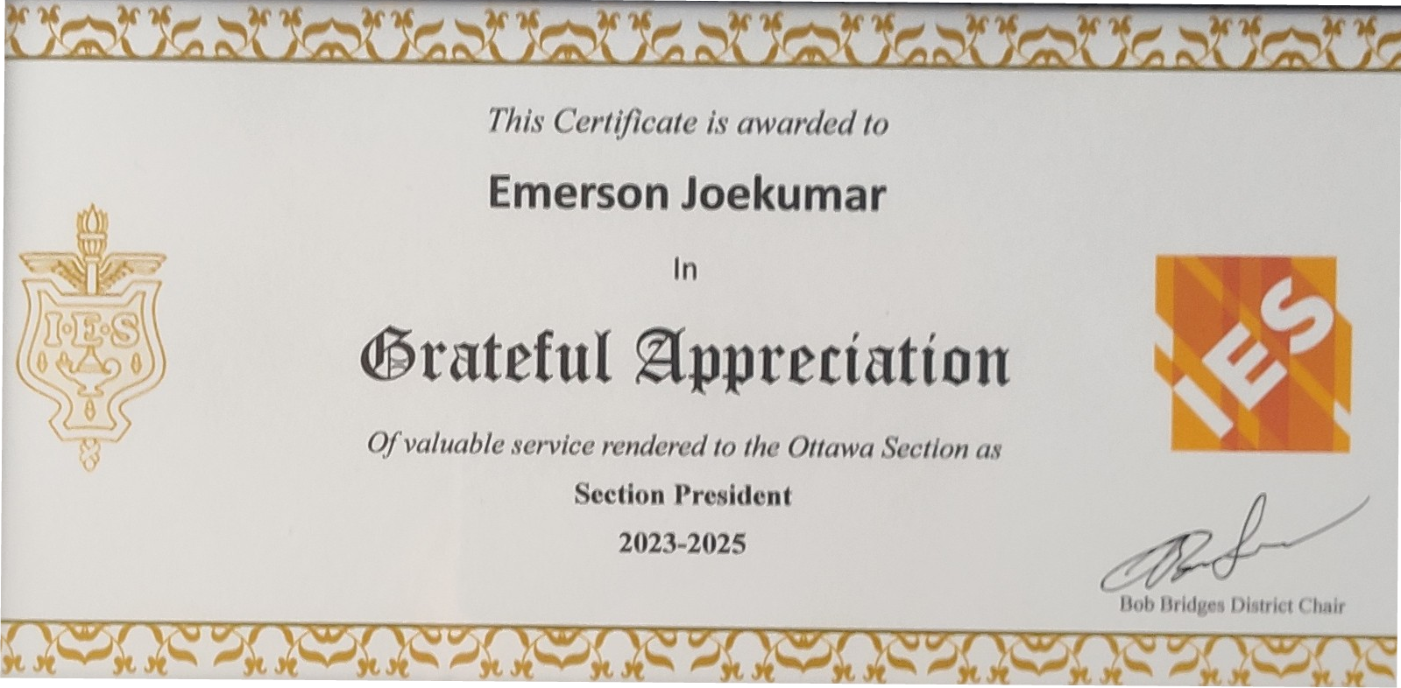

Images of the award

Slide 5
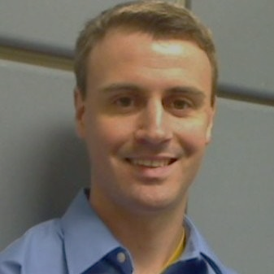
A Word From Our Section President Kristian Quosdorf
IES Ottawa

Slide 6



Sponsors
We Couldn’t Do This Without You

Slide 7
It takes a village Our volunteers are our village

Slide 8

Slide on Fundamentals
Fundamentals of Lighting Course
April 10, 17, 24
Review Session to follow

Slide 9
UPCOMING EVENTS
April 2nd – Chris Oulton Presenting Night Lights: Addressing Light Pollution & Dark Sky
April 29th – Dr. Jennifer Veitch
May 29th – GOLF

Slide 10
WE WOULD LOVE TO HAVE YOU ON OUR TEAM
Do you have some skills we could use?
Event Planning?
A network that includes
interesting potential speakers?
A “Getting Things Done” attitude?
We could use your help.

Slide 11
We will be back with the Indoor Lighting Presentations after a short break

